Slide 1

Presentation on
The Travel Blog
Web development
Of
Bachelor of Technology
By
Aindree Anil
Rituparna Banerjee
Shreyaskar Jaiswal
Department of Computer Science and Engineering
Ashoka Institute of technology & Management,
Paharia , Varanasi

Slide 2
Introduction: blog is a discussion or informational website published on the World Wide Web consisting of discrete, often informal diary-style text entries (posts).

Slide 3
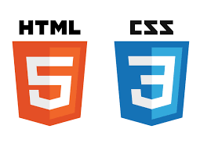
method: .
HTML(HYPER TEXT MARKUP LANGUAGE)
CSS(CASCADING STYLE SHEET)

Slide 4
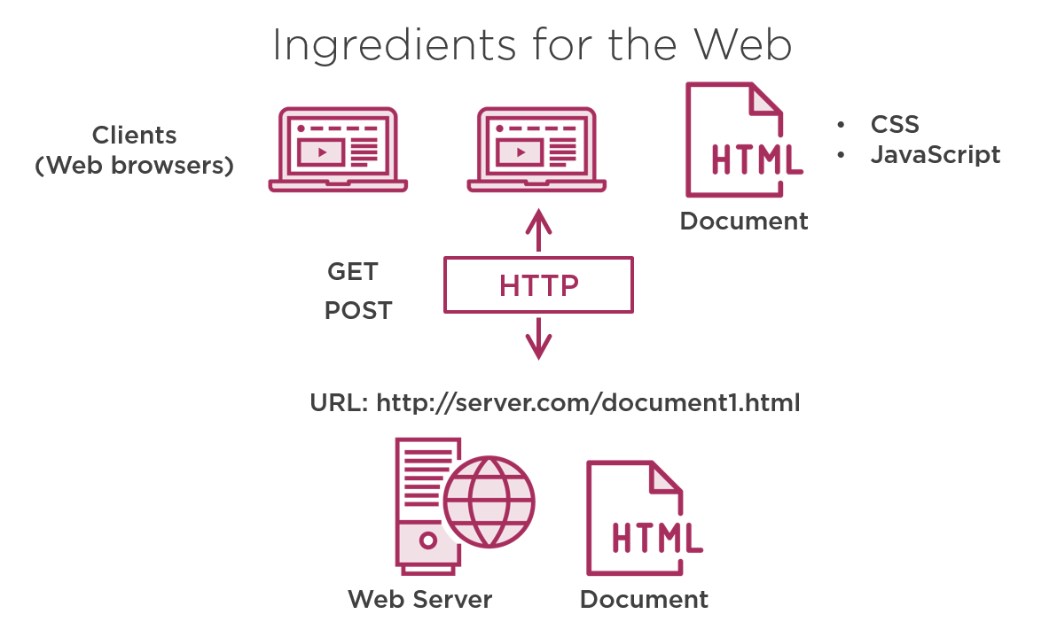

Slide 5
Aim:
We aim to create as much high-quality content, covering as many places as possible. All of which will help people travel and hopefully provide them the answers they want when they search on Internet.

Slide 6
OBJECTIVE:
The main purpose or objectve of our project is to provide all the information related to our city VARANASI to everyone through our webpage.

Slide 7


our logos:

Slide 8
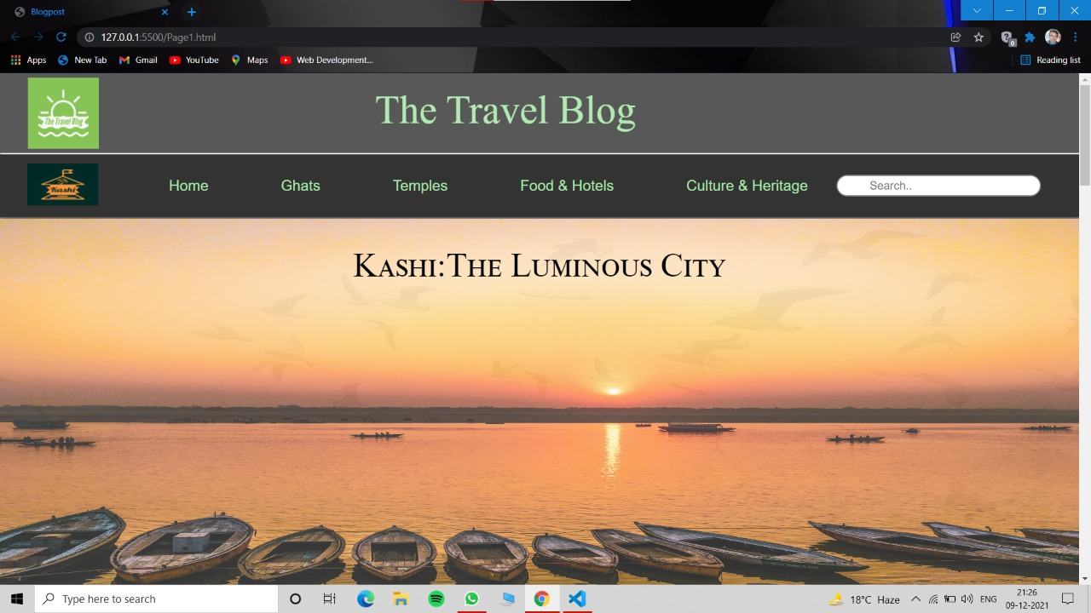
OUR LANDING PAGE:

Slide 9
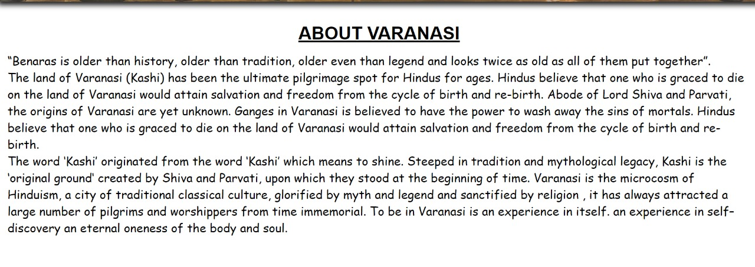

Slide 10
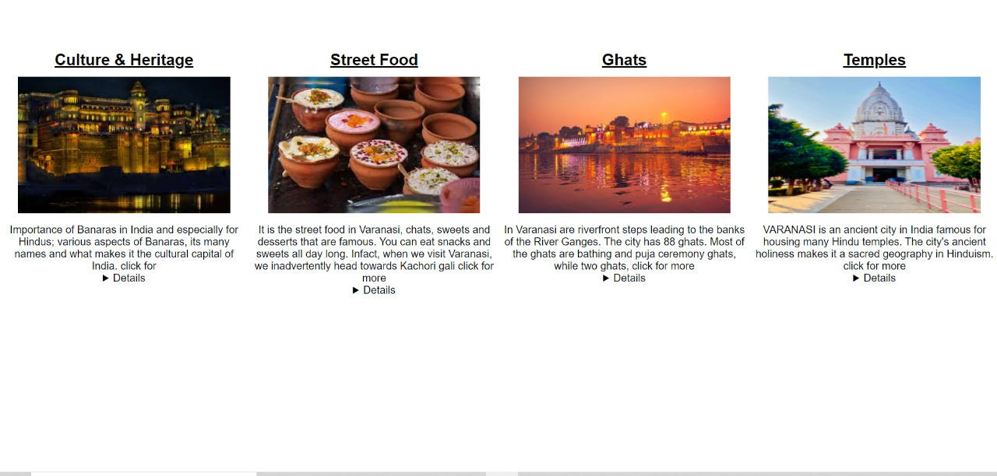

Slide 11
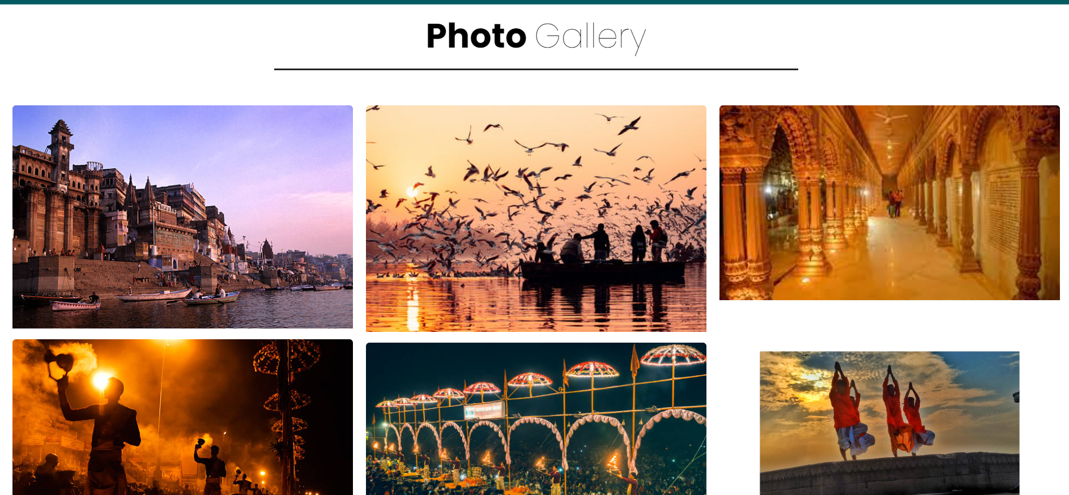

Slide 12
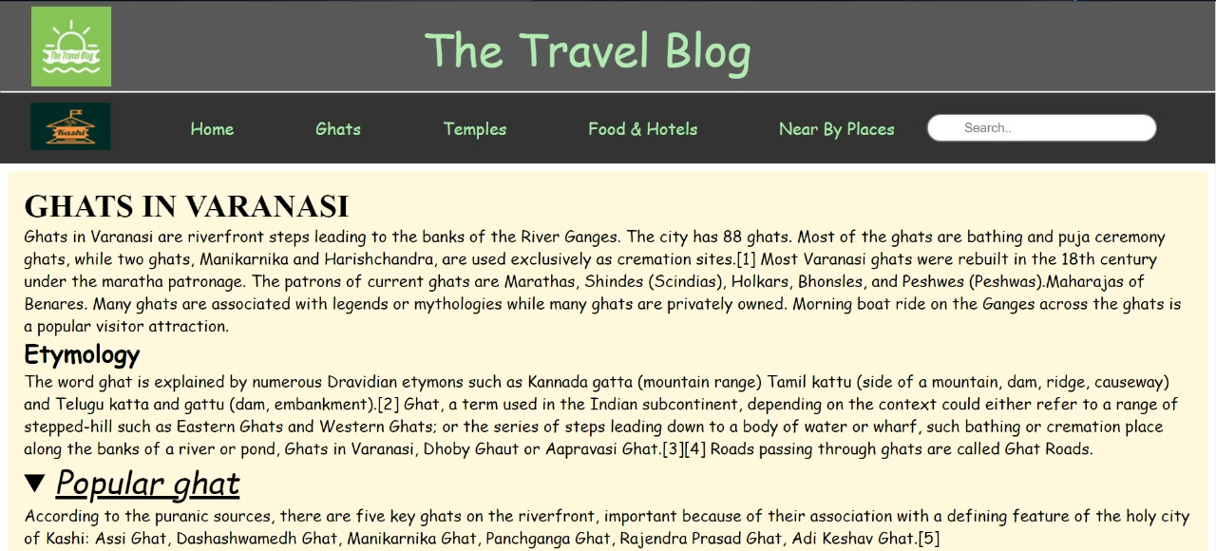

Slide 13
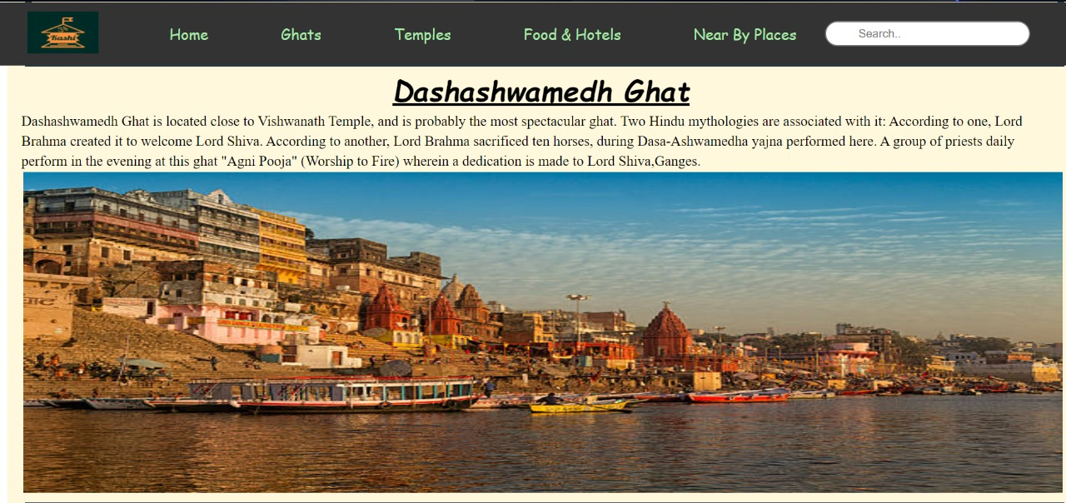

Slide 14
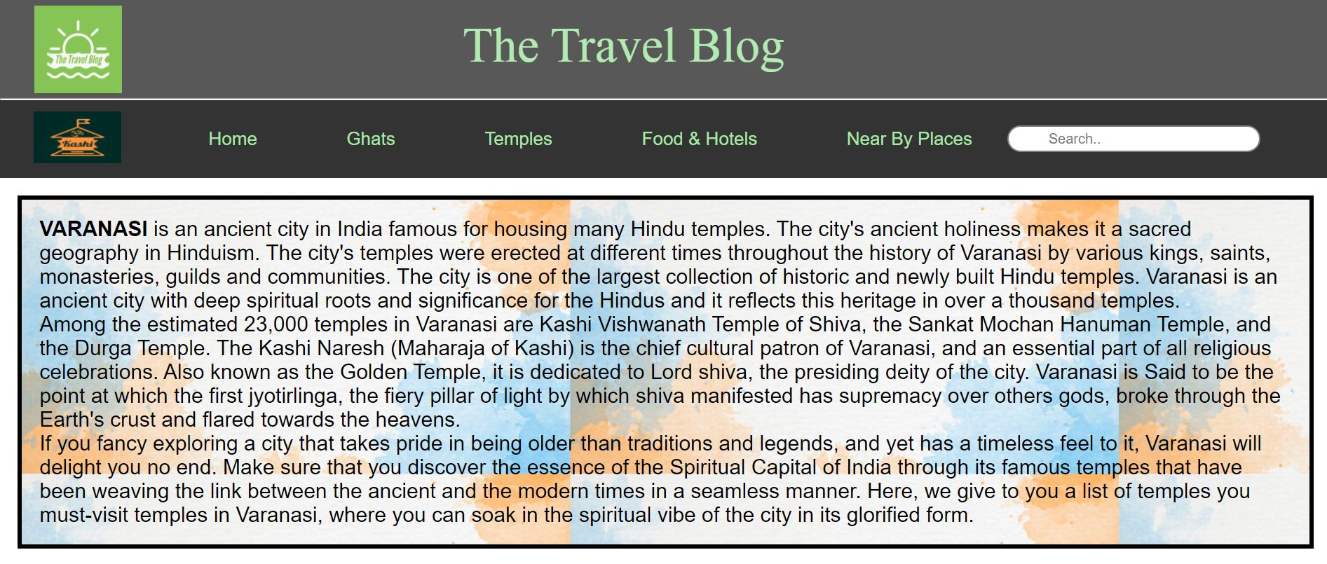

Slide 15
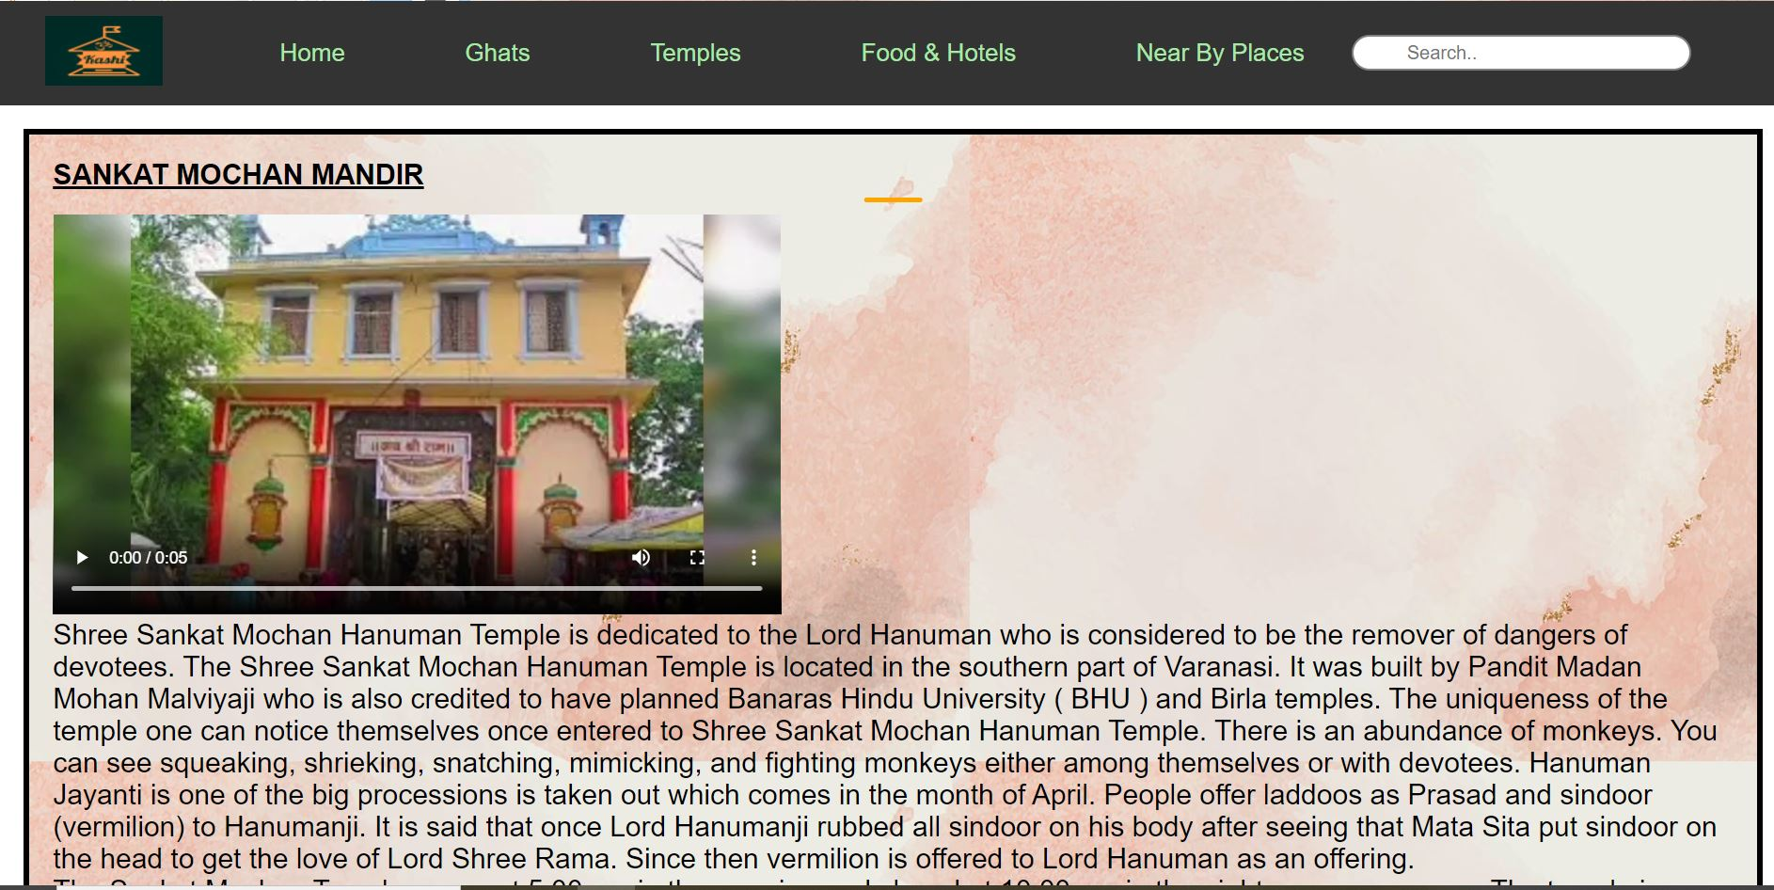

Slide 16
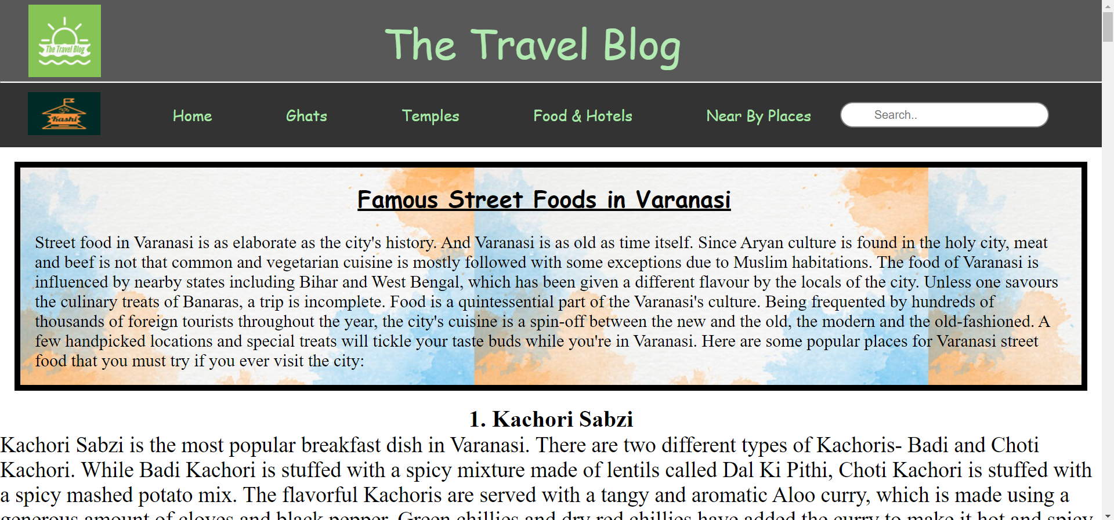

Slide 17
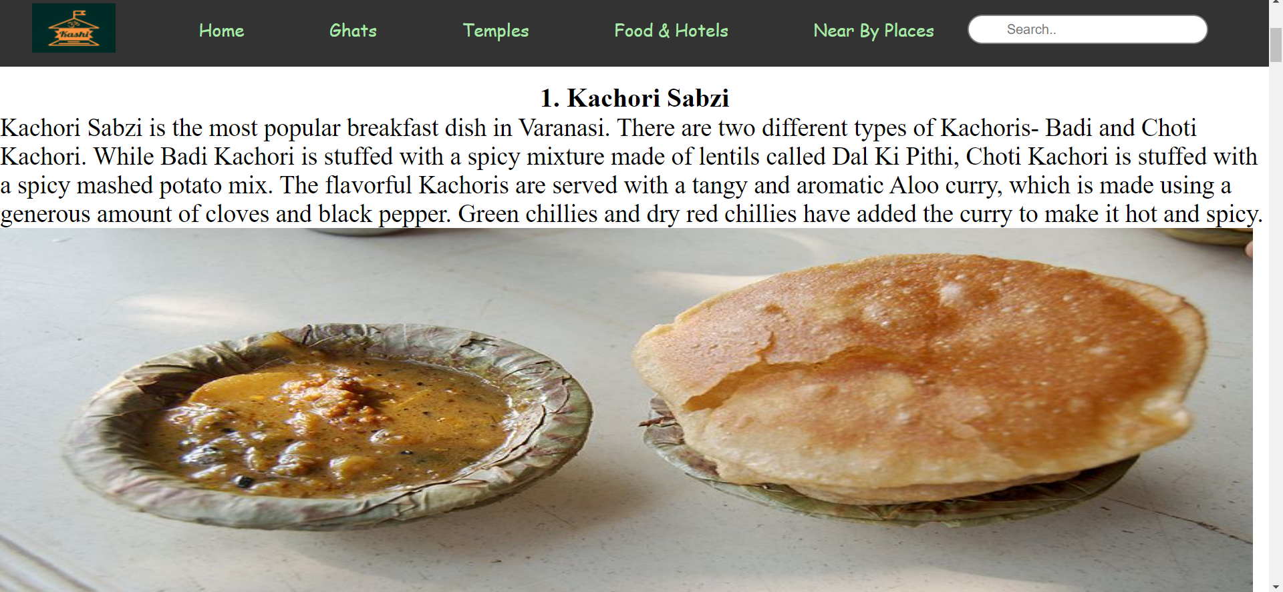

Slide 18
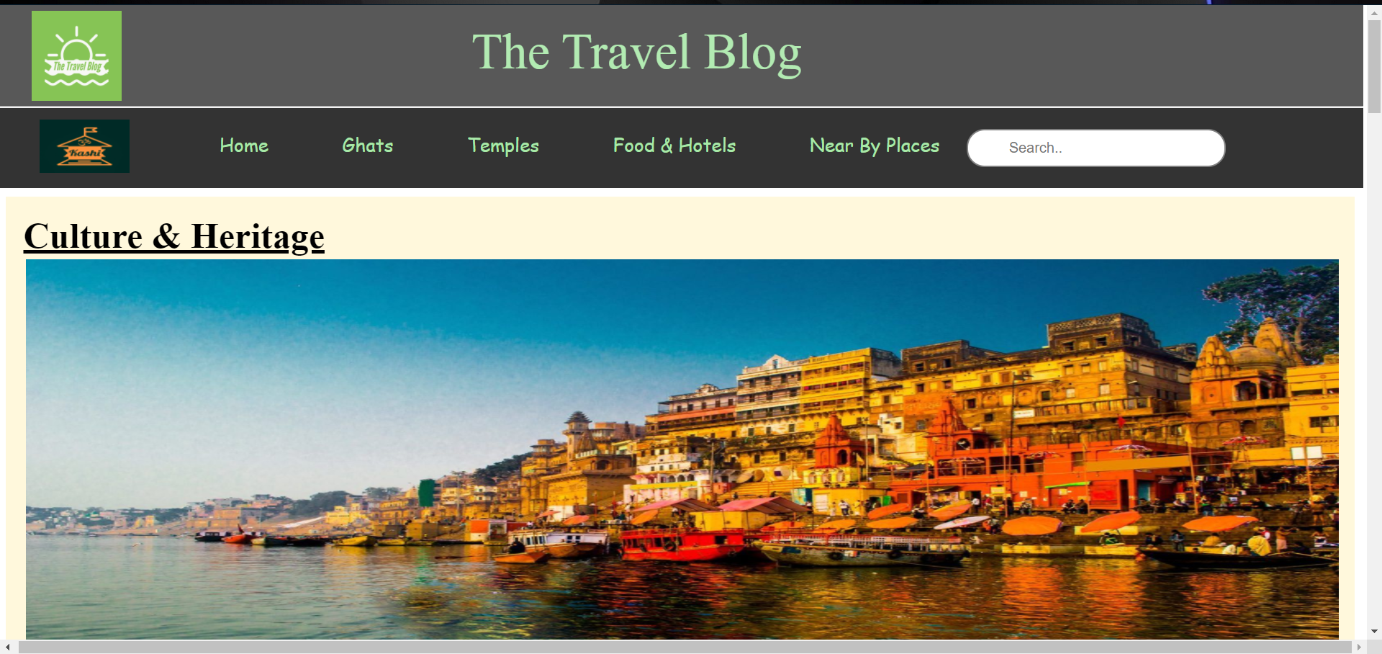

Slide 19
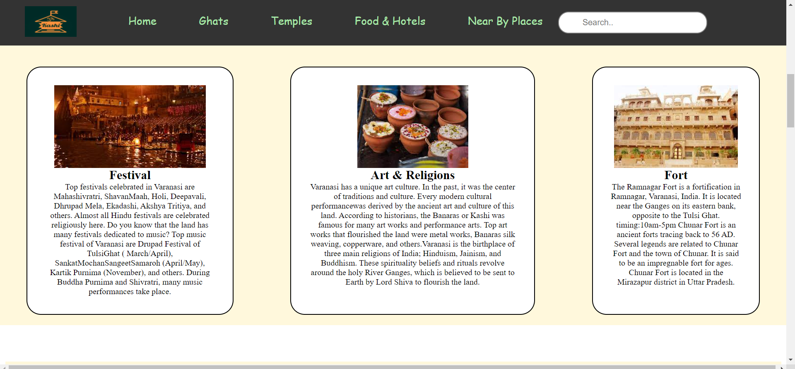

Slide 20
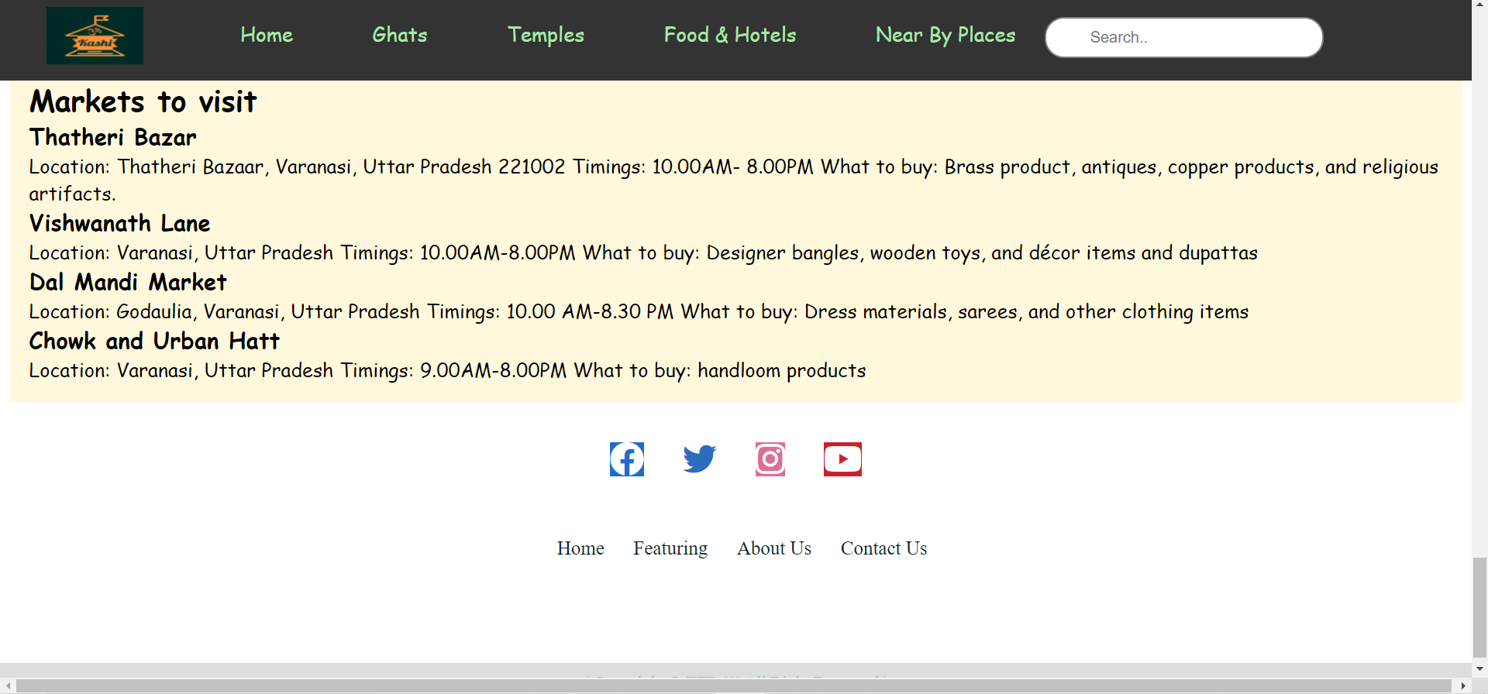

Slide 21
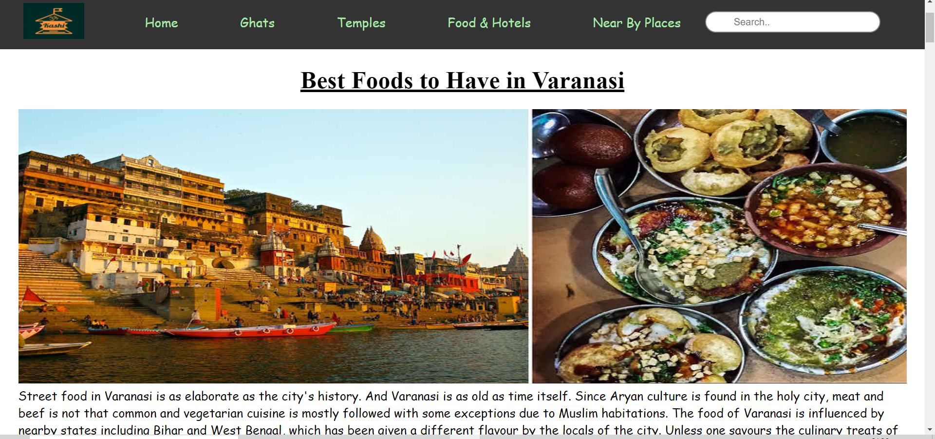

Slide 22
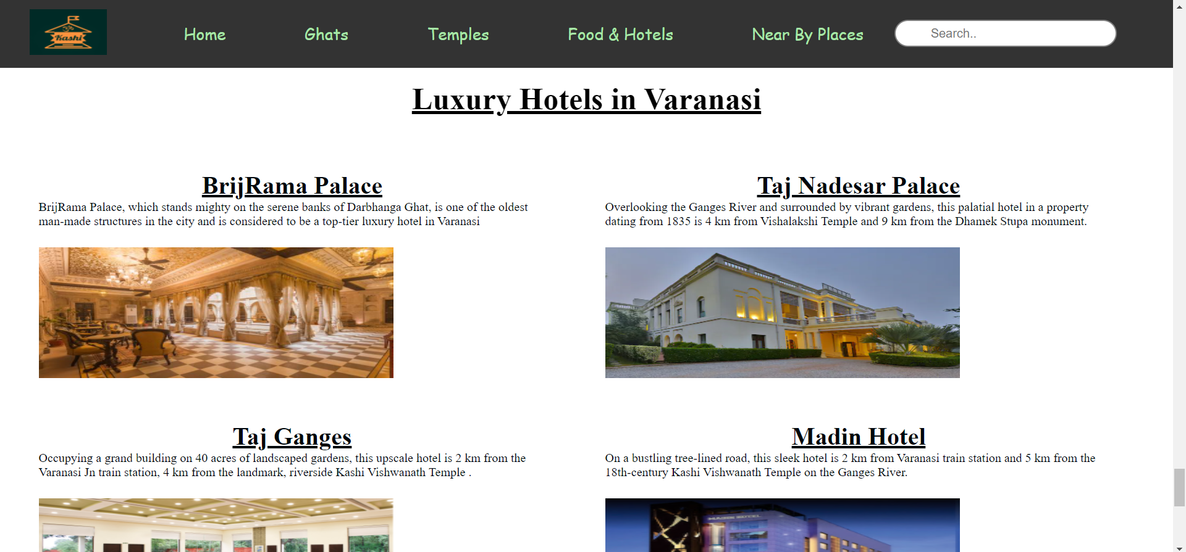

Slide 23
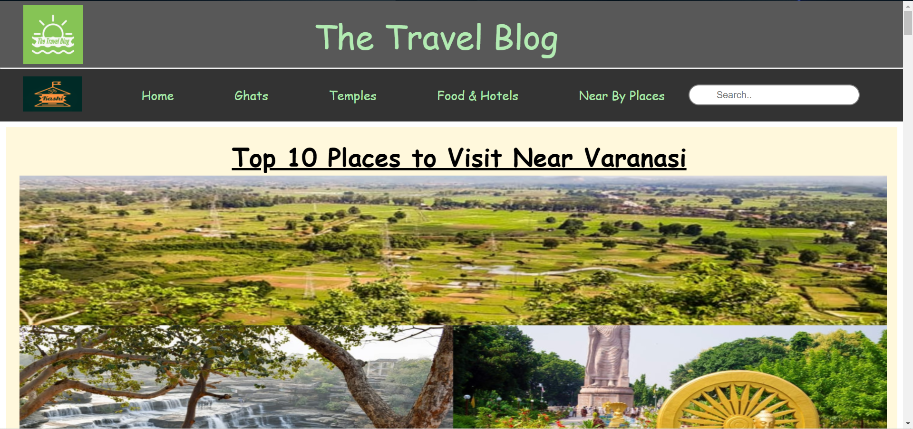

Slide 24
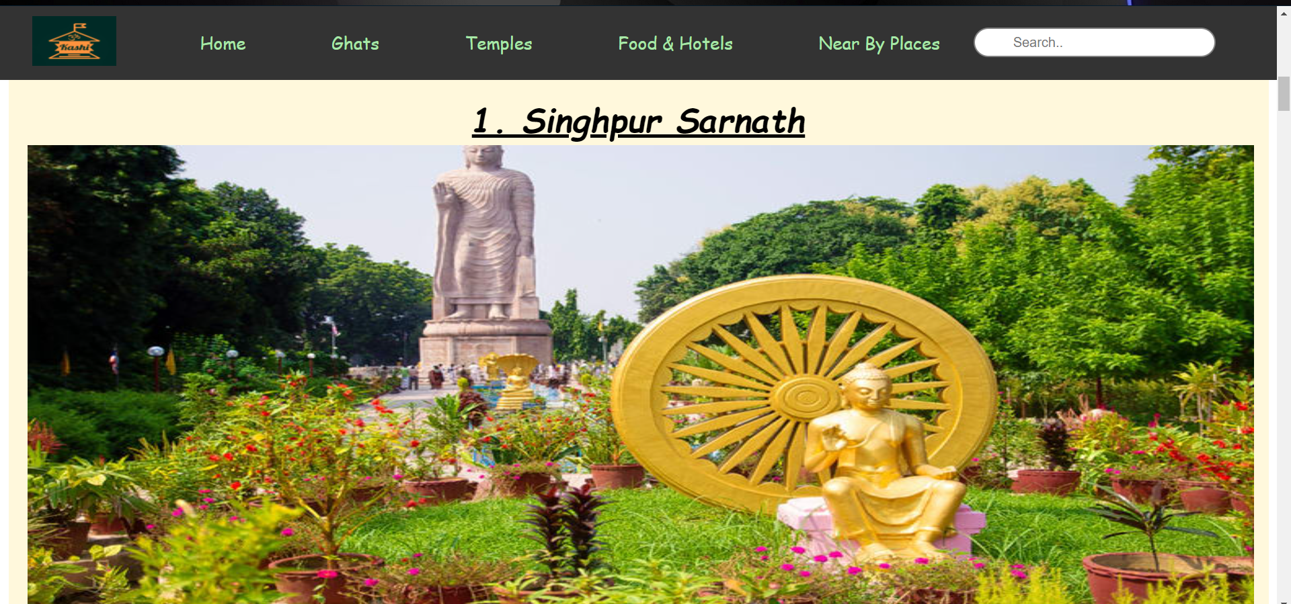

Slide 25
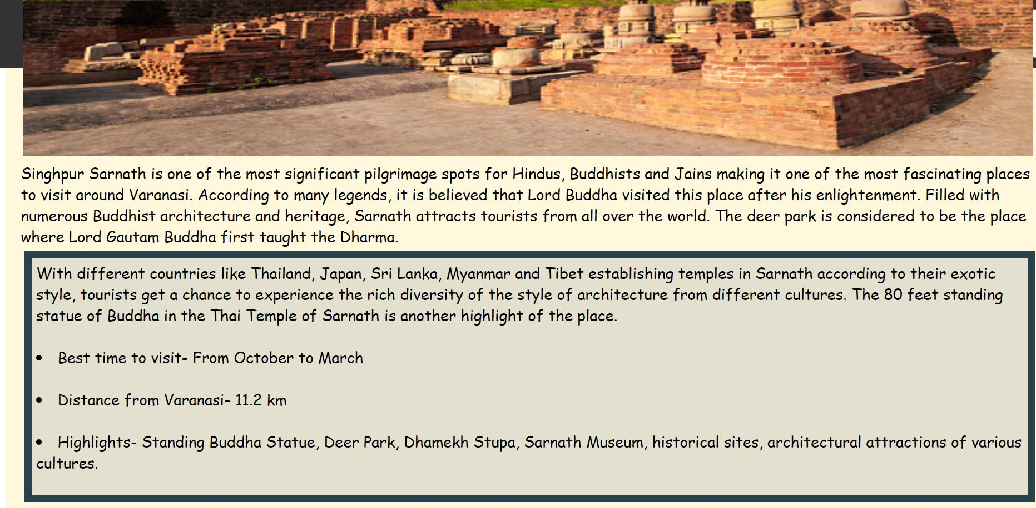

Slide 26
Future SCOPE: 1. But in future we will integrate it with IoTs like sensors and signal in equipments. 2. Integrating it with the iot is efficient to create User Interface. 3. Chatbot integrations will also be there. 4. Using iot solutions we will be able to check exact location, traffic details, and many more.

Slide 27
REFRENCES:
Below is the list of reference which we have followed during our whole project development journey.
Visual Studio Code
www.google.com
YouTube
Javatpoint
Google Maps API
Geeks for geeks
W3schools
Pexels

Slide 28
THANK YOU

